Slide 1
NEWS WAVE -Our News App
-By Purbasha Barik, Mehakdeep Kaur, Aruba Sood, Mayank

Slide 2
Purpose and Problem:
Information Overload: In today's digital age, we are bombarded with a vast amount of information from various news sources, leading to information overload.
Staying Informed: Amidst the abundance of news sources, users often struggle to stay informed about current events relevant to them.
Curated News Experience: There is a growing need for curated news experiences that filter and prioritize relevant news content tailored to individual interests and preferences.
Time Constraints: Many users have limited time available for browsing through multiple news sources to find the information they need

Slide 3
OVERVIEW OF THE APP
Splash Screen and Theme Setup
Onboarding Screens
HomeScreenActivity
Location Services with GetLocation Class
NewsUI
SavedNews Activity
Model-View-ViewModel (MVVM) Architecture
Networking with Retrofit
Database Access with Room

Slide 4
MAIN ACTIVITY
Splash Screen and Theme Setup:
- Installed a splash screen for smooth app entry.
- Applied the NewsAppTheme for consistent styling.
UI Composition with Jetpack Compose:
- Defined the app UI using onStartScreen composable function.
Navigation Handling:
- Implemented navigation to transition to HomeScreenActivity.
Intent Creation:
- Created an intent to navigate to HomeScreenActivity.

Slide 5



MAIN ACTIVITY

Slide 6
HOME SCREEN ACTIVITY
HomeScreenActivity is a pivotal component of the NewsApp, serving as the main interface for users to browse news articles.
1. Location Retrieval:
Fetches the user's location through the GetLocation class.
Retrieves the location asynchronously, handling potential delays.
Logs the retrieved location for debugging purposes.
2. News Data Retrieval:
Employs Retrofit library to execute API requests for news data(for different categories like health,science,Business etc.)
Implements fetchNewsData() method to handle API calls asynchronously.
3. Navigation:
Allows navigation to the SavedNews activity for accessing saved articles.

Slide 7
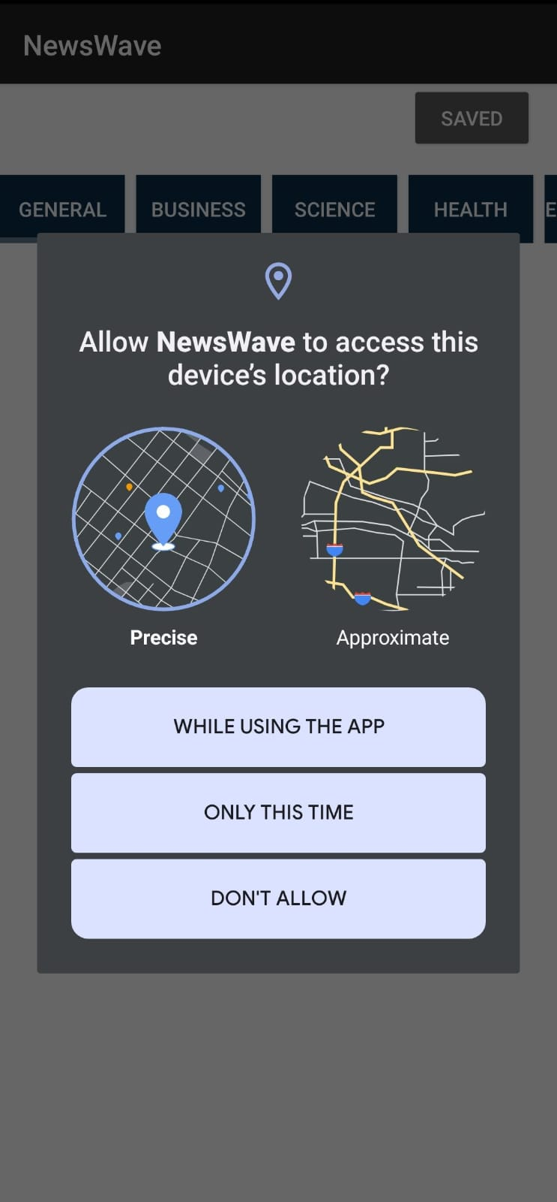
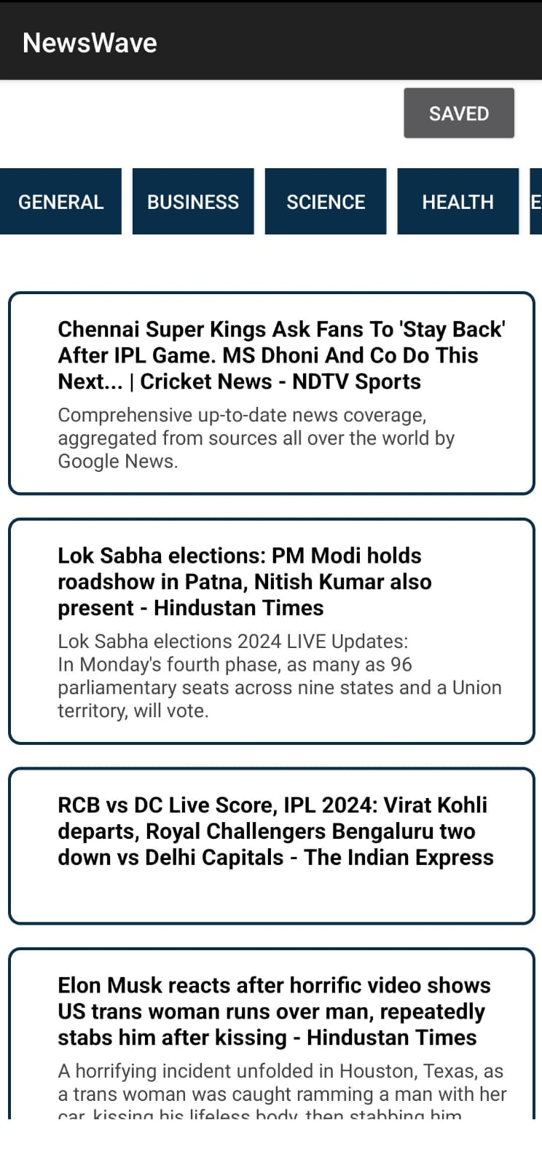
HOME SCREEN ACTIVITY

Slide 8
NewsUI
This activity displays the full content of a news article loaded in a WebView.
It provides buttons to:
Save the article to the device's storage using a Room database.
Share the news article using an Intent.

Slide 9
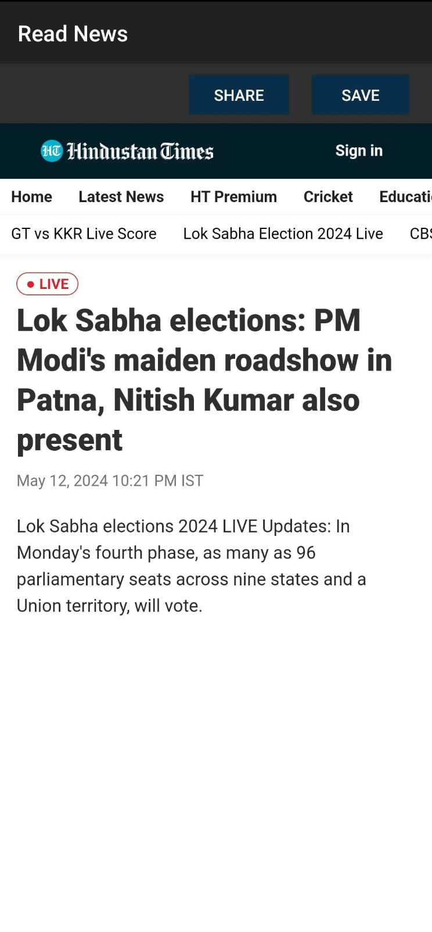
Read News

Slide 10
SavedNews
This activity displays a list of save
This activity displays a list of saved news articles retrieved from the Room database.
It uses a SavedNewsAdapter to populate the RecyclerView.
Clicking on a saved news article opens it in the NewsUI activity.
It provides a back button that navigates to the HomeScreen Activity

Slide 11
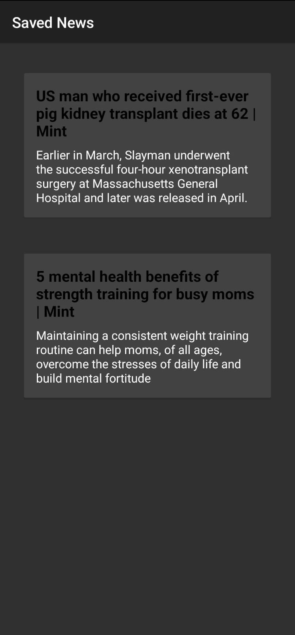
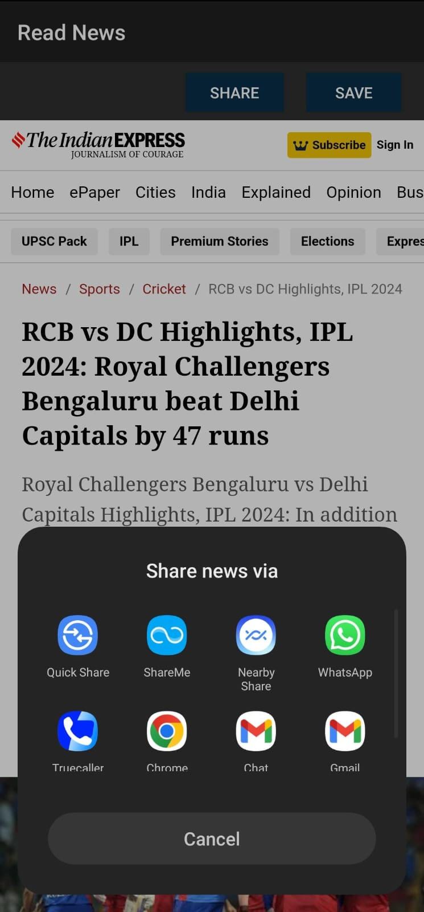
View the Saved News & Share News

Slide 12
NewsAdapter
Inner class representing a ViewHolder for news items in RecyclerView
Holds references to UI elements using ItemNewsArticleBinding
Implements View.OnClickListener to handle clicks on news item view
onClick method retrieves clicked article's position and URL
Calls onItemClick method of NewsItemClickListener (likely HomeScreenActivity)
bind method sets title, description, and potentially loads image for corresponding article

Slide 13
SavedNewsAdapter
Used in SavedNews activity to display saved news articles from the database
Takes NewsItemClickListener interface as constructor argument
Takes list of NewsItem objects representing saved news articles
onCreateViewHolder inflates layout for each saved news item using custom layout resource
onBindViewHolder sets title and description. onClickListener on ViewHolder calls onItemClick to open article.
onItemClick opens article in WebView, likely in SavedNews activity.

Slide 14
Data Models:
Article: Represents a news article with properties like author, content, description, etc.
NewsApi: Represents the response structure from a news API, containing articles, status, and total results.
Source: Represents the source information of a news article, including ID and name.

Slide 15
Networking with Retrofit:
NewsAppInterface: Defines API endpoint for fetching news data with Retrofit.
getNewsData method takes optional query parameters and returns a Call object.
newsService singleton: Creates Retrofit instance with base URL, uses GsonConverterFactory, and creates NewsAppInterface instance.

Slide 16
Database Access and Instance:
Singleton object Instance: Central access point to Room database.
Uses volatile variable database for thread-safety.
getDatabase method creates database instance using Room.databaseBuilder with migration logic.
giveInstance method (commented out) was an alternative approach but getDatabase is preferred.

Slide 17
Database Schema (NewsDatabase and NewsItem):
NewsDatabase: Abstract class representing the database.
Defines entities, currently NewsItem.
Specifies database version (version = 2) for schema changes.
Defines abstract method newsItemDao() to access DAO.
NewsItem: Represents a row in the "news" table.
Properties: id (primary key), title, description, url.
url column likely added in later version (version 2).

Slide 18
Database Migration (MIGRATION_1_2):
Migration object named MIGRATION_1_2 handles schema changes between versions 1 and 2.
migrate method adds "url" column to "news" table using SQL ALTER TABLE.

Slide 19
NewsItemDao:
Interface for "news" table interactions in the database.
Annotations specify database operations.
deleteAllNewsItems: Deletes all rows.
insertNewsItem: Inserts new NewsItem, replacing existing rows.
getAllNewsItems: Retrieves all rows as list of NewsItem objects.

Slide 20
GetLocation:
Retrieves user's country code using device's location.
Checks for ACCESS_FINE_LOCATION permission.
Retrieves last known location using LocationManager.
Converts coordinates to country code using Geocoder.

Slide 21
CONCLUSION:
Our news app, leveraged the use of Jetpack Compose and XML functionalities for creating visually engaging onboarding screens.
Furthermore, the GetLocation class showcased features for retrieving the user's country code through location services, suggesting potential for personalized news content based on location.
We have incorporated the functionalities of Saving as well as Sharing the news to different platforms.

Slide 22
References
Android Studio Offical documentation
API - newsapi.org
https://www.youtube.com/watch?v=bI5_lLovoy4
https://youtu.be/5cEyV9GwlnA?si=TkP-S2DZxK6h77vp
https://youtu.be/ZwmFEFRLrOA?si=G5QS56aoI1ddGyNu

Slide 23
THANK YOU

